Slide 1
Structural Equation Modeling (SEM)

Slide 2
Introduction

Slide 3
What is SEM?
Structural equation modeling (SEM) is a family of statistical procedures
  Analyze complex multivariate relationships
  Causal inference method
Great for testing theoretical variables and getting numerical outputs
  Takes qualitative, theoretical hypotheses and turns them into numeric estimates
Success isn’t based on if the model “fits” the data, but if the analysis is able to address those theoretical issues
(Kline, 2023)
Notes:
Rather than being one particular test the way that a t-test or an ANOVA functions, structural equation modeling is a family or umbrella of various statistical procedures, like confirmatory factor analysis or RI-CLPM
Used for analyzing super complex multivariate relationships and can be considered a causal inference method (talk about how complicated it gets haha)
We’ll get into this in the theory section, but SEM is particularly useful for when you have theoretical variables that can’t be tested in the same way a quantitative variable can (test scores vs. customer satisfaction)
One common misconception about SEM is that it “worked” if it says it fits your data, but that part actually does not matter, as it should fit your data perfectly regardless. The way you know that SEM worked is if it actually assesses the theoretical issue you care about regardless of whether the model fits or not.
Before we keep going, I wanted to see if anyone has used SEM before by a show of hands.

Slide 4
SEM: The Origin Story
Origins in the social psychology field
  Spearman’s factor analysis (1904)
    Looking at general intelligence underlying test performance
  Wright’s path analysis (1918; 1921)
    Biological and genetic focus
SEM is widely used in psychology
  Beierlein et al. (2016) → “group-focused enmity”
  Assess several different things in one model
(Bollen et al., 2022)
Notes:
We can start to see what some of the applications are of SEM when we look at its origins, which are actually in the psychology field starting with Spearman
Spearman wanted to examine general intelligence and see if it was underlying test performance, and to do so he used factor analysis to determine if various measures of general intelligence were actually assessing intelligence like he wanted
Wright was a little different and came from a biological background looking at rabbit bones and pigs, but was the first to suggest that path analysis could potentially include “hypothetical factors.” For him, that came in the form of hog breeding as a “latent variable,” which is a surprise tool that’ll help us later.
SEM is widely used today in pretty much every field, but especially psychology.
For example, Beierlen et al. in 2016 examined several types of discrimination, like sexism, xenophobia, racism, etc. using SEM, with one of their theoretical variables being “group-focused enmity,” or hatred toward minority groups. Using SEM allowed them to examine how all of these variables relate to one another and test a more abstract variable at complex levels
Today, SEM is used as kind of a “catch-all” statistical method. It can assess causal theories, handle missing data, look at assumptions and associations, and so much more all in one model.

Slide 5
Example Research Question
Industrialization and Political Democracy dataset (Bollen, 1989)
Two abstract variables:
  Industrialization
    x1: Gross National Product per Capita
    x2: Energy Consumption per Capita
    x3: Percentage of Labor Force in Industry
  Political Democracy
    y1: Freedom of the Press
    y2: Freedom of Political Opposition
    y3: Fairness of Elections
    y4: Effectiveness of the Elected Legislature
    Same 4 measured again in 1965, renamed y5, etc.
(Bollen, 1989; Rosseel & Vidal, 2025)
Notes:
We’re going to be using the industrialization and political democracy dataset, which comes from a study done by Bollen in 1989. We’ll be using this dataset moving forward to better understand the theory behind SEM, some of its components, and how to actually run it in R.
I’ll make a note that this dataset comes from the lavaan package that some other groups have mentioned before, and that’s how you run SEM in R. Another great dataset I considered using was the HolzingerSwineford1939 dataset because it’s more psychology-focused. However, it focused a ton on visual perception which went way over my head, so I consider the Political Democracy dataset to be more friendly, but I have the Holzinger dataset in the accompanying R-Markdown file if anyone wants to use it.
The Bollen dataset uses data from 1960 in various countries. It tests two more abstract variables using several quantitative variables.
The first variable is industrialization, which is measured using three variables: x1, or the gross national product per capita, x2, or the energy consumption per capita, and x3, or the percentage of labor force in industry
The second variable is political democracy, which is measured using four variables: y1, freedom of the press, y2, freedom of political opposition, y3, fairness of elections, and y4, effectiveness of the elected legislature

Slide 6
Example Research Question
Does a country’s industrialization level predict its political democracy in 1960?
Do political democracy and industrialization in 1960 predict its political democracy in 1965?
(Bollen, 1989; Rosseel & Vidal, 2025)
Notes:
For this presentation, we’re going to address two general research questions. I want to make a note that I am heavily basing this off of Rosseel & Vidal’s (2025) analysis of Bollen (1989) and the math behind it, so our research questions should align with the code they provided.

Slide 7
Theory

Slide 8
Components of SEM
Observed variables vs. latent variables
  Observed → the variables you actually collected data for
  Latent → hypothetical constructs
An indicator is an observed variable that reflects a latent variable
A factor is the statistical version of a latent variable
Two main structures:
  Covariance → Assesses variances/covariances; r_{XY}*SD_{X}*SD_{Y}
  Mean → Estimation of means on latent variables
Structural model → relationship among the constructs themselves
(Kline, 2023; Rosseel & Vidal, 2025)
Notes:
One of the main components of SEM is its distinction between observed and latent variables. Essentially, observed variables are what you actually measured. In the Political Democracy dataset, it’s variables like gross national product or freedom of the press. Latent variables are the hypothetical variables. In our dataset, that’s industrialization and political democracy. Another good example of a latent variable is intelligence.
An indicator is an observed variable that measures a latent variable. For example, in our dataset, energy consumption is an indicator of industrialization because it’s reflecting that latent variable.
A factor is basically just a statistical version of a latent variable for when we’re looking at the SEM model
There’s also two main structures in an SEM model: a covariance structure and a mean structure.
The covariance structure represents the strength of a linear correlation between two variables because it uses a Pearson’s correlation and then multiplies it against the standard deviation of each variable.
The mean structure isn’t used as much, but it’s basically the estimation of means on the latent variables. So for example, in contrast to ANOVAs, with an SEM, you can estimate the magnitude of group mean differences
One final component to be aware of is the structural model, which is the relationship among the latent constructs themselves
There’s a million other components and definitions with SEM that are outlined by several books, including the one I keep referencing by Kline, but this is a good foundation for us to move forward

Slide 9
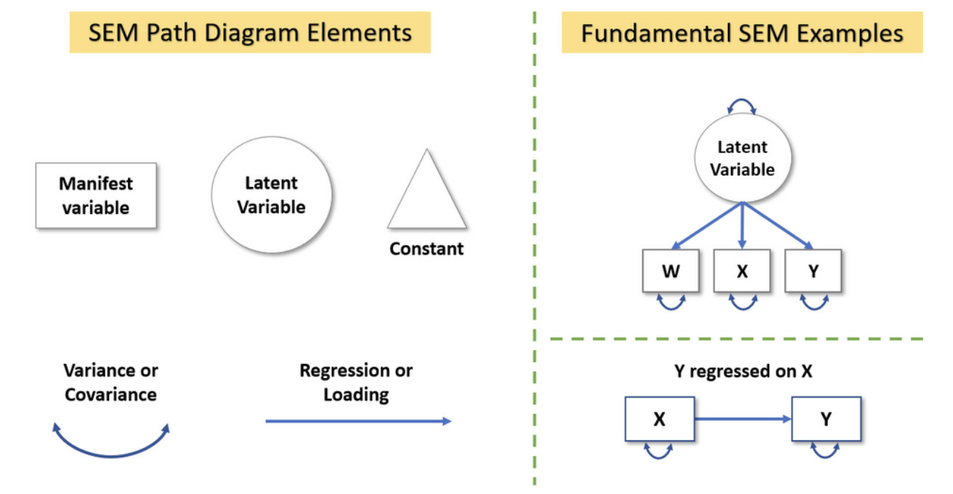
Graphing SEM
(Castro-Schilo, 2021)
Notes:
Another important thing to know about SEM is how the modeling and graphing works. Some of these graphs get extremely complicated, so I wanted to provide a simpler example that breaks down the parts of a model and how it can look.
I got this diagram from Castro-Schilo, and it is of course linked in the references if anyone would like to look.
The manifest variable is just the observable variable, and is represented as a rectangle. The latent variable is always a circle, and you can see how the latent variable is made up of the observable variables o the right.
Triangles are used to represent constants, which help enable the estimation of means and intercepts. If there’s not restrictions on variable means, this is usually omitted.
One-headed arrows are regressions or loading, and loading is just a regression of an observed variable on the latent variable.
Double-headed arrows represents variances in a single variable, which can be seen on the right. If there was a double-headed arrow between X and Y though, for example, that would indicate covariance.
I don’t want to dwell too much here because this will make more sense when we look at our own data, but it is important to understand what parts make up SEM graphs because they can get insanely complicated.

Slide 10
SEM Assumptions
Multivariate normality
Linearity
No perfect multicollinearity
No systematic missing data
Sufficiently large sample size
  N:q rule → Sample size/model parameters ratio; 20:1
Correct model specification
  Specification error → omission of relevant variables
Independence of observations
No extreme outliers
(Kaplan, 2001; Kline, 2023)
Notes:
There’s several assumptions for SEM. However, I will be very honest with you all, it was extremely difficult to find straight answers on what things are assumptions and what matters. Ultimately, it looks like the rule of thumb is to do whatever is consistent with your field, but here are a few assumption examples that I could find. We’ll go over how to assess them in R as well.
First is multivariate normality. Not only do individual variables need to be normally distributed, but their combinations should as well. I’ve seen some sources say you can use residuals and others say to do specific R tests, so stick with whatever your field typically does.
Similarly to other tests we’ve learned this semester, the relationships between variables should be linear
You also want to avoid perfect multicollinearity, as that could indicate issues with your data. Some multicollinearity appears to be fine, especially since two observed variables might be indicators for the same latent variable. Estimation problems can arise if multicollinearity is particularly high
While SEM is equipped to deal with missing data, you’ll want to make sure you don’t have systemic missing data, like everyone from one zip code is missing.
This is not an official assumption, but sample size is vital to running SEM. Kline in his book discusses the N:q rule, which is the ratio between your sample size and how many model parameters you have that will require statistical estimates. 20:1 is recommended. For instance, if you are going to have 10 estimates, then you’ll do 20 times 10, which is 200 for the proper sample size.
You’ll want to make sure you’ve correctly specified your model by including ALL of the relevant variables and not just purposefully omitting some
As with other tests, you want to make sure there’s independence of observations. However, there are certain SEM models that are equipped for mixed models or within-subjects data, but this is the general rule of thumb.
And finally, you want to check that you do not have any extreme outliers.
I want to reiterate that again, it was extremely hard to find assumptions for SEM, and I think it is because there are so many tests that fall under the SEM umbrella that there’s always an exception or a different assumption. I once again recommend leaning on your field’s typical assumptions or looking at the specific type of analyses you’d like to run.

Slide 11
Strengths & Weaknesses
Strengths
Weaknesses
Distinguishes between observed vs. latent variables
Address abstract questions
Exploratory and confirmatory analyses
Extremely powerful
Comprehensive and complex analyses
Super complicated
Requires large samples
Easy to misinterpret
Goodness-of-fit tests can be misleading
Inappropriate for nonlinear data
Still developing
(Kline, 2023; Tomarken & Waller, 2005)
Notes:
Now that we’ve got a theoretical foundation, let’s talk about some of the strengths and weaknesses. In SEM, the strengths are extremely strong and the weaknesses are extreme weak spots, so keep that in mind.
One of the main strengths of SEM is that it can distinguish observed and latent variables. For example, when conducting a study, if you think “x1-x3” represents industrialization and “y1-y4” represents political democracy, SEM can actually analyze that and distinguish between them. ANOVAs and linear regressions absolutely cannot.
Because SEM is so complicated, it can address abstract questions and constructs in ways that other tests cannot, which makes it extremely popular
You can do both exploratory and confirmatory analyses with SEM, which can be great for data analysis
It’s also an extremely powerful analysis, especially because it’s typically used a priori
All of these strengths demonstrate its main strength, which is the fact that it’s a comprehensive and complex analysis that can assess a ton of different things in one model
But for all of these strengths, there are quite a few weaknesses, with its main one being it is ridiculously complicated. There’s so much room for potential error for those unfamiliar with SEM, and I am sure that I have probably messed up a few things here and there despite my research because of how confusing it can be
It also requires a large sample size. We talked about the N:q rule earlier, but there’s also a rule of thumb of having a minimum of 100 participants, which can be difficult in some lab settings to achieve
It’s extremely easy to misinterpret because it can be so complicated
Tomarken & Waller discuss in detail how some of the goodness-of-fit tests can be misleading when people report them, which is why Kline in 2023 mentions it’s not as relevant (and is mildly confusing). It’s very easy to move from one goodness-of-fit test to another until you can say that you have a model that has a good fit, even if it doesn’t
It’s inappropriate for nonlinear data since one of the assumptions is that the data is linear
And finally, SEM is constantly in development! Researchers continue to come up with new analyses under the SEM umbrella that can make it feel impossible to keep up with, and I was definitely feeling that while creating this presentation.

Slide 12
When Will I Ever Use This?
This is great for…
  Model variables that can’t be measured directly
  Model variables with measurement error
  Models where variables are both predictors/outcomes
  Testing theories/concepts
  Handling missing data
Potential alternatives:
  Factor score path analysis for small samples (Devlieger & Rosseel, 2017)
  Multilevel modeling for nested data (Mehta & Neale, 2005)
(Castro-Schilo, 2021; Kline, 2023)
Notes:
Despite how complicated it is, SEM is an extremely useful tool for data analysis. Whenever you have variables that are abstract or theoretical, SEM is the perfect model to use. For example, in our dataset, SEM is appropriate because we’re trying to analyze industrialization and political democracy, which we can’t literally measure without observable variables like energy consumption or freedom of press.
It’s also great for handling things like measurement error and missing data because it uses sophisticated analyses to do so
Finally, it’s great for when you have variables that are both predictors and outcomes. In this class, we’ve essentially only talked about tests where there’s a clear DV and a clear IV, but not when they’re interchangeable. SEM is a fantastic way to assess those relationships
From my research, it doesn’t look like there’s a ton of alternatives to SEM, just that there’s versions of it that can suit whatever need you have
One alternative I found is factor score path analysis, which is useful for small samples
I also found information about multilevel modeling being an alternative if you really just feel like torturing yourself for a few hours. There’s versions of SEM that involve multilevel modeling, but I’m listing it here anyways

Slide 13
R Demonstration
Notes:
Go to R Markdown file

Slide 14
Interpretation
Notes:
Now that we’ve seen how to run SEM in R, let’s analyze what our outputs actually mean, along with the graph

Slide 15
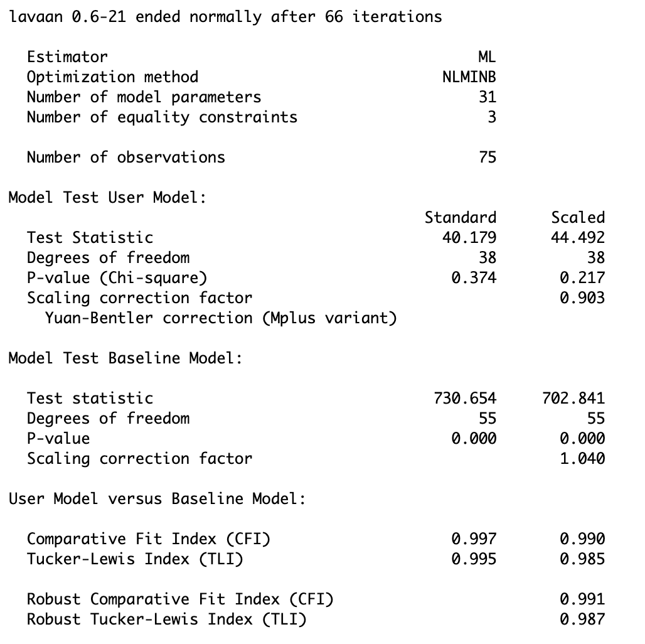
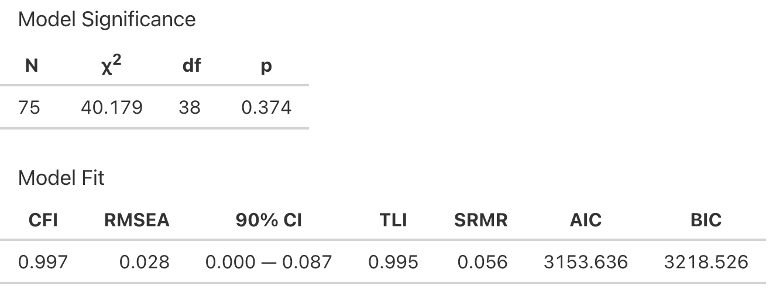
Interpretation: Model Fit
Our Chi-square is insignificant, p = .374
Our CFI is .997, which means our model closely fits the data.
Notes:
First, let’s take a look at our model fit. On the left, you’ll see the normal R and lavaan output. This output can be really useful for when you need specific values, but I recommend using the sem_tables function from the semoutput because it is much easier to look and and interpret.
The first output we’ll look at is our model test user model. The main thing we’re going to look at here is the result of a chi-square analysis. In SEM, the null hypothesis of the chi-square test says that there is NO difference in the covariances predicted by our model and the actual data. Therefore, we want a nonsignificant value similar to normality and homogeneity of variance tests we’ve done in the past. Our chi-square is insignificant, which indicates that we have a good model fit.
The next thing we’ll take a look at is the User Model versus Baseline Model. In the next slide, we’ll talk about even more goodness-of-fit tests, but the comparative fit index (CFI) and robust tucker-lewis index (TLI) are the ones in this area. The one that seems to be the most commonly used is the CFI, so I’ll focus on that one, but just know that the TLI is very similar.
CFI ranges from 0-1.0. A 1.0 means there is no departure of fit in our model from the null model. A CFI of greater than .9 or .95 is typically acceptable. Our CFI is greater than both of those and is pretty close to 1.0, so our model closely fits the data.

Slide 16
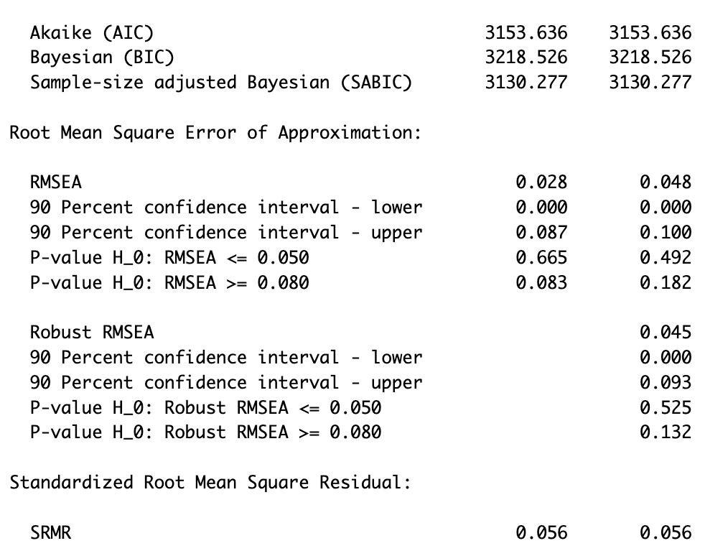
Interpretation: Model Fit
Other fit indices indicate that our model fits the data!
Notes:
Now we’ll get into some other fit indices. For demonstration purposes when we get to the interpretation in APA section, I won’t be including all these, but it’s best practice to include at least a couple fit indice results when reporting your SEM model.
Let’s look at the AIC and BIC. Where do we recognize the AIC from? [wait for answer] It’s a model criterion for when we’re doing like stepwise or backward regression stuff to determine our variables! If you recall, there’s not really a cutoff for AIC, it’s just kind of a matter of did it decrease. We can’t necessarily see that here, but it’s good to know that’s what it means. BIC is just a different version, for our purposes we’d probably go with AIC.
Next is the Root Mean Square Error of Approximation (RMSEA). The RMSEA is a bit of an ugly duckling in that it’s a BADNESS-of-fit test, meaning the closer the 0 it is, the better. Our RMSEA is .028 with a tiny confidence interval, which indicates that our model is NOT a bad fit. When reporting the RMSEA, you would want to also report the confidence interval.
Finally, we have the SRMR. The SRMR measures the overall difference between the observed and predicted correlations (so basically their residuals). An SRMR of > .10 may indicate poor fit. Ours is only .056, so we’re good.
Overall, these fit indices all agree that our model fits the data! Hooray!

Slide 17
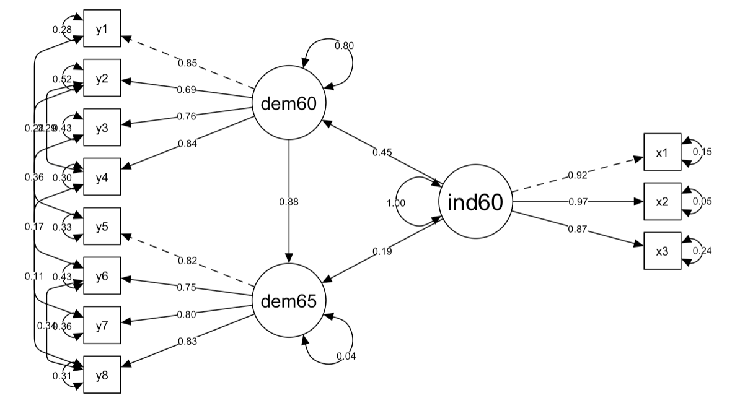
Model Visualization
Notes:
Before we get into the meat of the interpretation with the actual regression values, I want to remind everyone of what we’re looking for and visually demonstrate the results with a graph.
This graph is very scary, but we’re going to break it down along the way. As a reminder, all of these variables outlined in purple are manifest or observable variables. They’re what we actually measured in the study, so stuff like energy consumption or gross national product per capita.
The variables in orange are our latent variables, or the more conceptual, abstract concepts we’re testing. So for example, variables x1, x2, and x3 are basically actual measures that indicate or legit measure industrialization in 1960 since we can’t literally ask about industrialization, so we have to measure it in other ways.
These arrows pointing to just the variable or between the variables are the variances. If the two-headed arrow is pointing to just one variable like we see with political democracy in 1960, that’s indicating its variance. If the two-headed error is between two variables, that’s signaling covariance.

Slide 18
Model Visualization
Notes:
Similar concept here. All of these variables are related to democracy in 1960. So y1-y4 are indicators of democracy in 1960.
Variables x1-x3 are indicators of industrialization in 1960.
And then finally, variables y5-y8 are indicators of democracy in 1965.
As you’ll see shortly, we want to not only see the correlations between our three latent variables, but also want to see that our indicators or observable variables are actually measuring/indicating these latent variables.

Slide 19
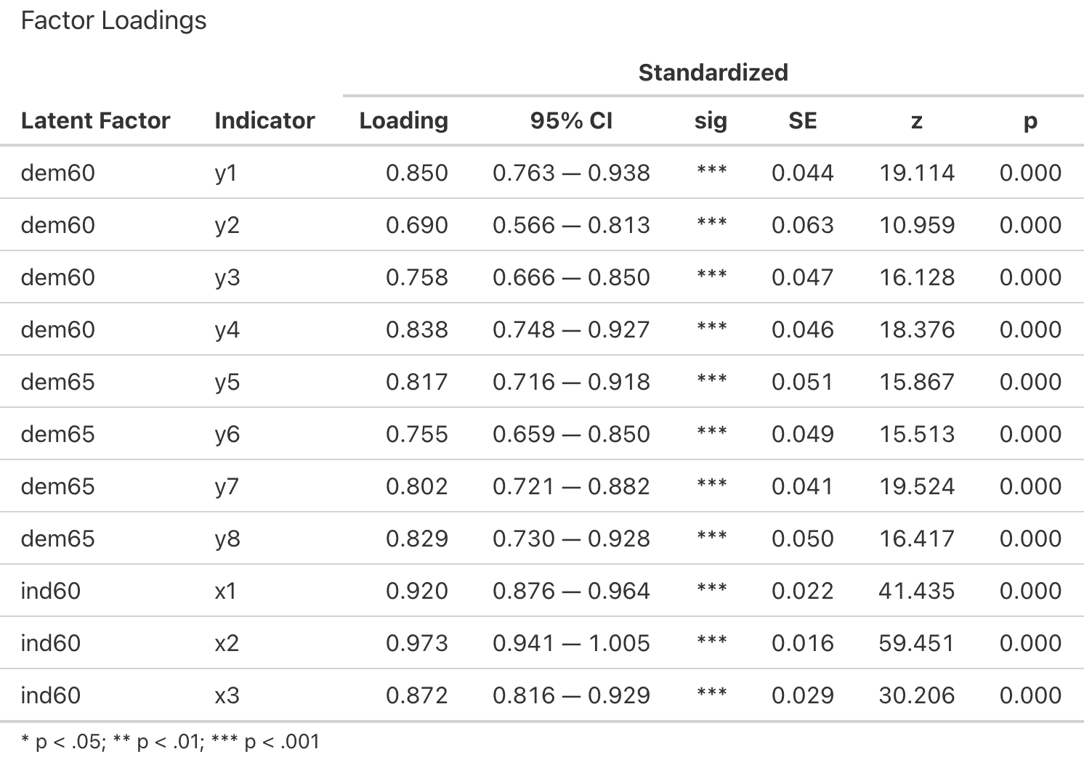
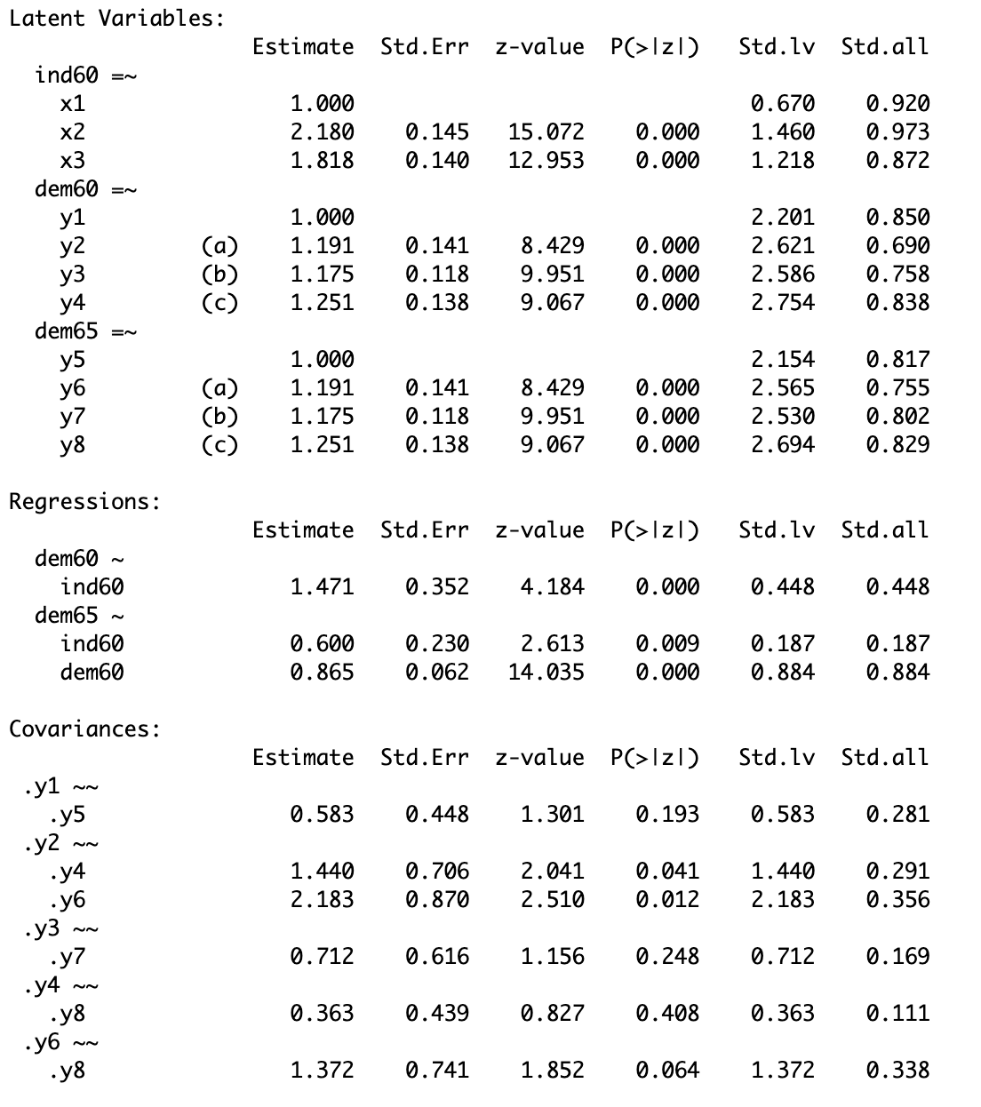
Interpretation: Factor Loadings
Our factor loadings are all strong and significant, so they do a good job indicating our latent variables
Notes:
What we are seeing here are factor loadings. As a reminder, factor loadings are basically just correlations/regressions of each of the measured variables on the latent variable. By checking the factor loadings, we’re making sure that these observable variables do a good job indicating their respective latent variable.
For example, we can see here that the factor loadings of y1-y4 are strong and significant with political democracy in 1960. This means that these variables are good at indicating political democracy 1960. As a reminder, this included things like freedom of speech, press, etc., so this is saying that those things do a good job of indicating a country’s political democracy in 1960.
We see the same thing with industrialization in 1960 and political democracy in 1965. The variables all are strong and significant, so they do a good job of indicating our latent variables.

Slide 20
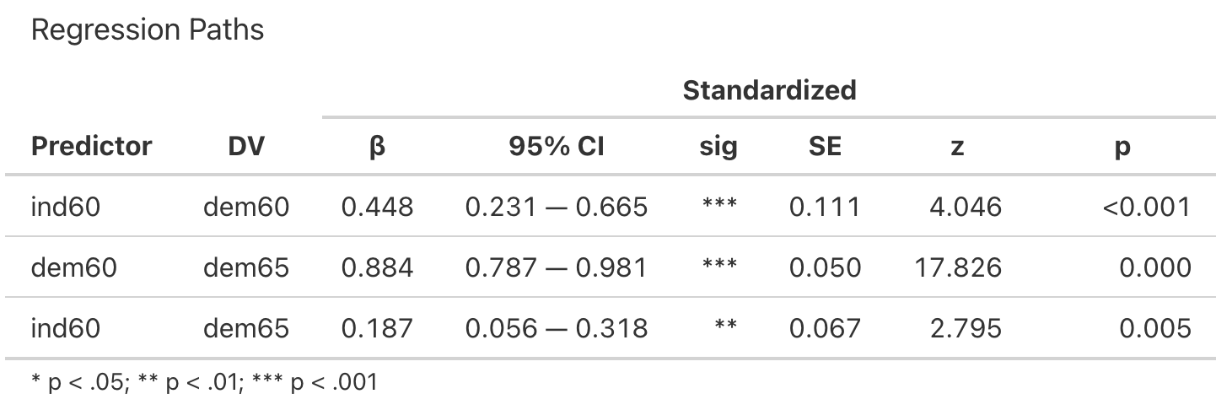
Interpretation: Regressions
Notes:
Now that we know our model fits and our observed variables are good indicators of our latent variables, let’s actually look at the regressions between each of these latent variables.
Our first research question was does a country’s industrialization in 1960 predict its political democracy in 1960, which we can see here. If we take a look at the R outputs, we can see that yes, industrialization does predict democracy. Our p-values are significant, and this version of the output even gives us our standardized betas that we can report.
Our second research question was do political democracy and industrialization in 1960 predict political democracy in 1965? Let’s first look at political democracy in 1960 and political democracy in 1965. Again, we see that yes, political democracy in 1960 does predict democracy in 1965 based on our significant p-value. Same thing with industrialization in 1960 and political democracy in 1965.
So all of our regressions added in the model were significant! When reporting, we’ll report the standardized betas, standard errors, and p-values.

Slide 21
Model Visualization
Notes:
Let’s take one final look at our model. What we found was all of these observed variables do a good job of indicating their respective latent variables. We also found that the regressions were each significant. These SEM models can be a great way to visualize our findings, but a downside is that in R, it’s very difficult to look at just the correlation between democracy in 1960 and industrialization in 1960 for example. But for looking at the overall model and how everything relates to each other, this can be an extremely useful tool. Now, we just need to report these findings.

Slide 22
Reporting SEM Results
The SEM model was evaluated and demonstrated a good fit to the data. The Chi-square test was not significant, χ²(38) = 40.18, p = .374. The CFI was .997, which indicates the model fit the data. Analysis of the regression paths showed that a country’s industrialization level in 1960 significantly predicted its political democracy in 1960, β = .448, SE = .111, p < .001, indicating higher industrialization was associated with higher political democracy scores.
Moreover, a country’s political democracy in 1960 significantly predicted its political democracy in 1965, β = .884, SE = .050, p < .001. Political democracy in 1965 was also significantly predicted by industrialization in 1960, β = .187, SE = .067, p = .005. These results indicate that political democracy level (1960) is associated with later democratic development (1965). Results also suggest that industrialization is generally associated with democratic development.
Notes:
Here is what an example of an SEM report in APA 7 looks like! We’ll break it down, but we’re just taking everything we’ve talked about so far and putting it into a couple paragraphs.
Again, for demonstration purposes, I’m only reporting the chi-square and CFI. Kline (2023) recommends at least reporting the chi-square, RMSEA and its confidence interval, CFI, and SRMR. I was not writing all that in an airport, so you’ll have to make do.
We also make sure to report the standardized betas, standard errors, and p-values for the regressions

Slide 23
References
Beierlein, C., Kuntz, A., & Davidov, E. (2016). Universalism, conservation and attitudes toward minority groups. Social Science Research, 58, 68–79. https://doi.org/10.1016/j.ssresearch.2016.02.002
Bollen, K. A. (1989). Structural equations with latent variables. John Wiley & Sons. https://doi.org/10.1002/9781118619179
Bollen, K. A., Fisher, Z., Lilly, A., Brehm, C., Luo, L., Martinez, A., & Ye, A. (2022). Fifty year of structural equation modeling: A history of generalization, unification, and diffusion. Social Science Research, 107, https://doi.org/10.1016/j.ssresearch.2022.102769
Castro-Schilo, L. (2021). Structural equation models. Towards Data Science. https://towardsdatascience.com/structural-equations-models-3d8578952f87/
del Rosario, K. (2024). Introduction to lavaan: Mediation and SEM. RPubs. https://rpubs.com/kareena_delrosario/lavaan_intro_medsem
Devlieger, I., & Rosseel, Y. (2017). Factor score path analysis: An alternative for SEM? Methodology: European Journal of Research Methods for the Behavioral and Social Sciences, 13(Suppl 1), 31–38. https://doi.org/10.1027/1614-2241/a000130
Gana, K., & Broc, G. (2019). Structural equation modeling with lavaan. Wiley. https://doi.org/10.1002/9781119579038
JMP. (n.d.). Structural equation modeling. https://www.jmp.com/en/statistics-knowledge-portal/structural-equation-modeling
Kaplan, D. (2001). Structural equation modeling. In N. J. Smelser & P. B. Baltes (Eds.), International Encyclopedia of the Social & Behavioral Sciences, 1521–15222. Pergamon. https://doi.org/10.1016/B0-08-043076-7/00776-2
Kline, R. B. (2023). Principles and practice of structural equation modeling (5th ed.). The Guilford Press.

Slide 24
References
Kumar, S., & Upadhaya, G. (2017). Structure equation modeling basic assumptions and concepts: A novices guide. International Journal of Quantitative and Qualitative Research Methods, 5(4), 10–16. https://eajournals.org/ijqqrm/vol-5-issue-4-september-2017/structure-equation-modeling-basic-assumptions-concepts-novices-guide-2/
Mehta, P. D., & Neale, M. C. (2005). People are variables too: multilevel structural equations modeling. Psychological methods, 10(3), 259–284. https://doi.org/10.1037/1082-989X.10.3.259
Rosseel, Y., & Vidal, M. (2025). A tutorial for understanding SEM using R: Where do all the numbers come from? British Journal of Mathematical and Statistical Psychology, 00, 1–38. https://doi.org/10.1111/bmsp.70003
Spearman, C. (1904). “General intelligence,” objectively determined and measured. The American Journal of Psychology, 15(2), 201–292. https://doi.org/10.2307/1412107
Tomarken, A. J., & Waller, N. G. (2005). Structural equation modeling: strengths, limitations, and misconceptions. Annual Review of Clinical Psychology, 1, 31–65. https://doi.org/10.1146/annurev.clinpsy.1.102803.144239
Tsukahara, J. (2023). semoutput: SEM output. https://github.com/dr-JT/semoutput

